Slide 1

CS 470 Project Two Conference Presentation: Cloud Development
Lindsey Delorenzo
October, 2025

Slide 2
Overview
Thank you for joining today
The purpose of this presentation is to address cloud development to both technical and nontechnical audiences.
Lindsey Delorenzo

Slide 3
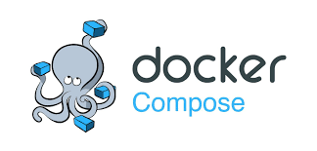
Containerization
MODEL The Cloud Services model for this Docker Project uses Amazon Web Services (AWS) to manage its features.
TOOLS The tools needed for this project include Docker Compose with YAML for service, API Gateway for script configuration, AWS Lambda functions and IAM services for security and user authorization.

Slide 4
Orchestration
WHY? Docker Compose, as explained by Marko (2024), helps utilize composition of containers with automated testing environments, single hosts deployments, and develops environments.
BENEFITS The benefits of using Docker Compose is its fast and straightforward configurations, secure internal communication, portability and CI support, efficient resources, and strong DevOps support (Marko, 2024).

Slide 5
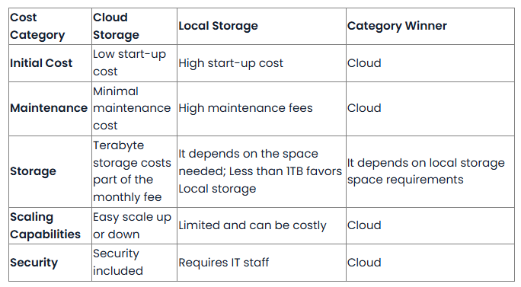

The Serverless Cloud
Serverless
What is “serverless”? Serverless is when system is saved and loaded from a cloud based location while not having a standard physical local storage. There are many advantages for cloud based servers such as its unlimited storage, cheaper start up and maintenance costs, backup recovery, and easy collaboration for remote work.
S3 storage S3 is a Simple Storage Service from Amazon Service. It have all the scalability, data availability, security, and high performance. Cost for maintenance and start up are low and the storage is unlimited. S3 makes it easy for files to be accessible for server crashes and for compliance check for data protection laws.
Figure 1
1 Choosing between cloud and local storage (Jungco) is a chart comparison of Cloud storage versus Local storage. Jungco, Kezia. (February 15, 2023, Updated February 25, 2025). Cloud Storage vs. Local Storage. TA Technology Advice Blog. https://technologyadvice.com/blog/information-technology/cloud-storage-vs-local-storage/

Slide 6
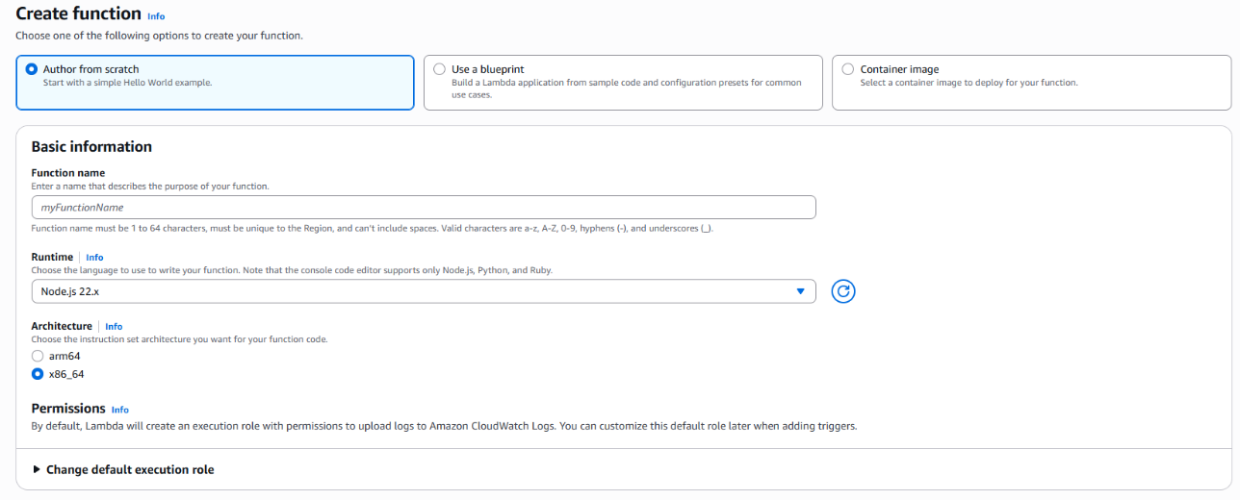

The Serverless Cloud
API & Lambda
Lambda API logic a serverless model that charges per execution and memory. Scripts logic for Lambda include Python, Node.js, C#, Java, Go, or Ruby. AWS Lambda functions are straightforward, easy, quick, easy to security features to and can handle amounts of traffic requests.
The steps need to create a Lambda function are:
Click Create Function
Choose “Author from Scratch”
Give the function a name
Select a run time
Click on the Create Function
Next add the code and test.

Slide 7
The Serverless Cloud
Differences between MongoDB and DynamoDB
QUERES. The queries within a DynamoDB designed as key-valued items, giving each item within the database a primary key. MongoDB stores its data in documents.
SCRIPTS
MongoDB has JavaScript-based Scripts that are executed through MongoDB. These Scripts can handle more complex queries.
DynamoDB can be used with multiple data types and interacts with AWS CLI. It may not be able to handle as complex queries. However, AWS makes up for it by handling all security, upgrades, server management, and high availability.

Slide 8
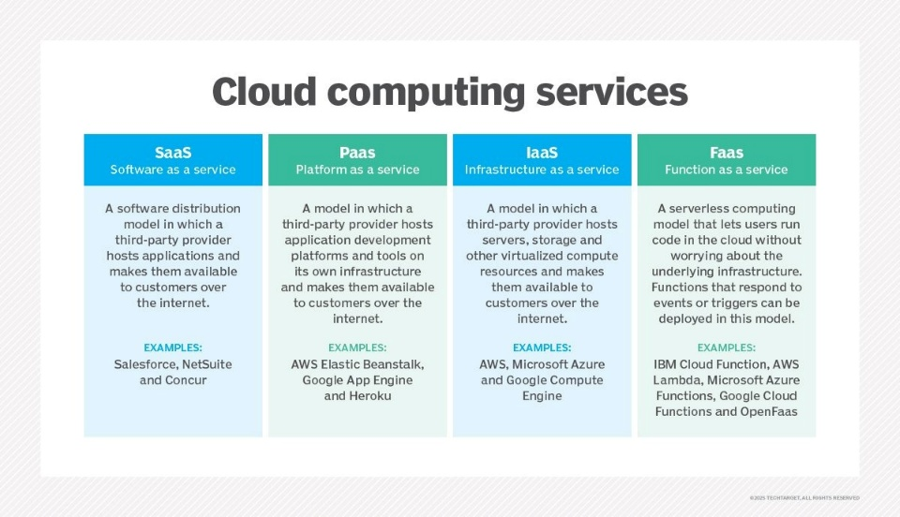
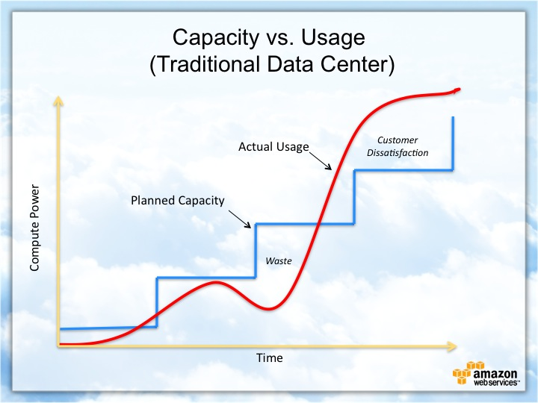
Cloud-Based Development Principles
ELASTICITY. Elasticity with cloud-based development is great for development teams. This auto adjust of resources helps with real time based workload demands.
Pay-for-Use Model. This model allows companies to pay for the data used only instead of a monthly fee. This saves cost for unused resources during low use times and creates a simple understanding of the billing cost.
Cloud Computing service Mobile
Kovvuru, ismail. (2025) Cloud Computing Service Mobile [image model] Medium. https://medium.com/@ismailkovvuru/elasticity-scalability-high-availability-in-aws-cloud-architecture-22dce7301271

Slide 9
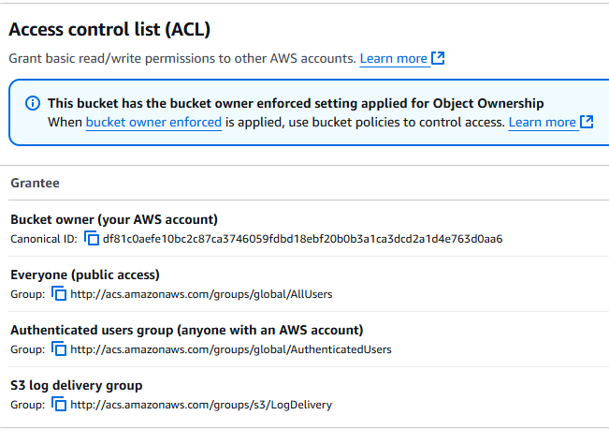

Securing Your Cloud App
IAM roles and policies.
IAM. AWS Identity and Access Management is a control access feature with AWS.
IAM role is an identity permission that gives access to a user.
IAM policy is a JSON code that give specific permissions.
We secured permissions within the project with Lambda and Gateway using header mappings access control and the LabRole.
S3 bucket Access control image
S3 Bucket. These bucket access links display permissions for the different types of users. This is an example granting different access per each type of user.

Slide 10
Conclusion
Cloud development has more benefits for applications for any company.
It allows for straightforward costs.
It can be used from multiple locations.
It can be easy developed between teams with its dependency support.
There are strong security and authentication features.
Back-up options are much safer for troubleshooting crashes.
Thank you for your time.

